Slide 1


c17 portfolio Project: Family Day Out Planner By Yuan fang jacQueline lu matthew brinkmann

Slide 2

What are we trying to achieve
We are aiming to assist families in planning short trips or days out. We will provide a list of activities in an area and pair that with the weather at the location.
This will also help plan detours in larger holidays by finding activities near the location the family is staying at.

Slide 3
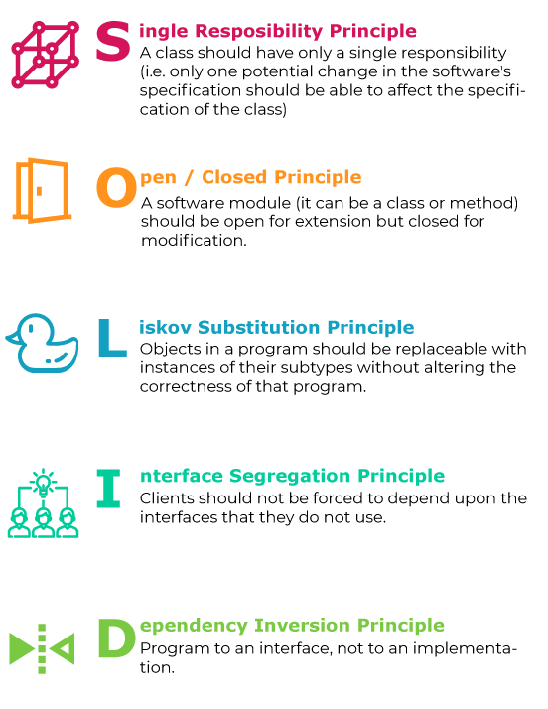

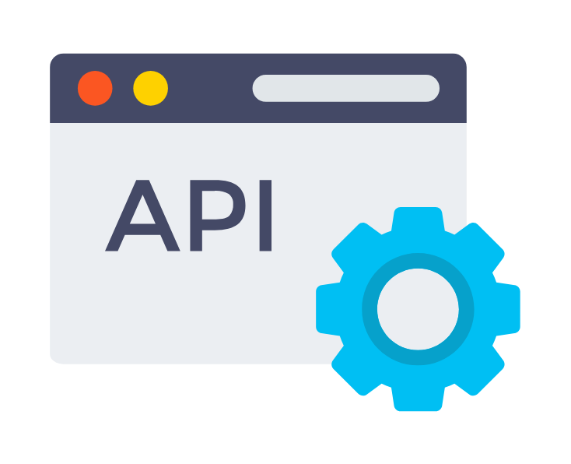

Our Goals:
We are looking to reinforce our learning with this project, it’s not so much about what we create, but how we create it and how well put together it is.
Solid Code (S.O.L.I.D. principles)
Unit Testing – Code coverage
Interact with external API
Create our own API

Slide 4



TECHNOLOGY
Python
Flask
React
Docker

Slide 5
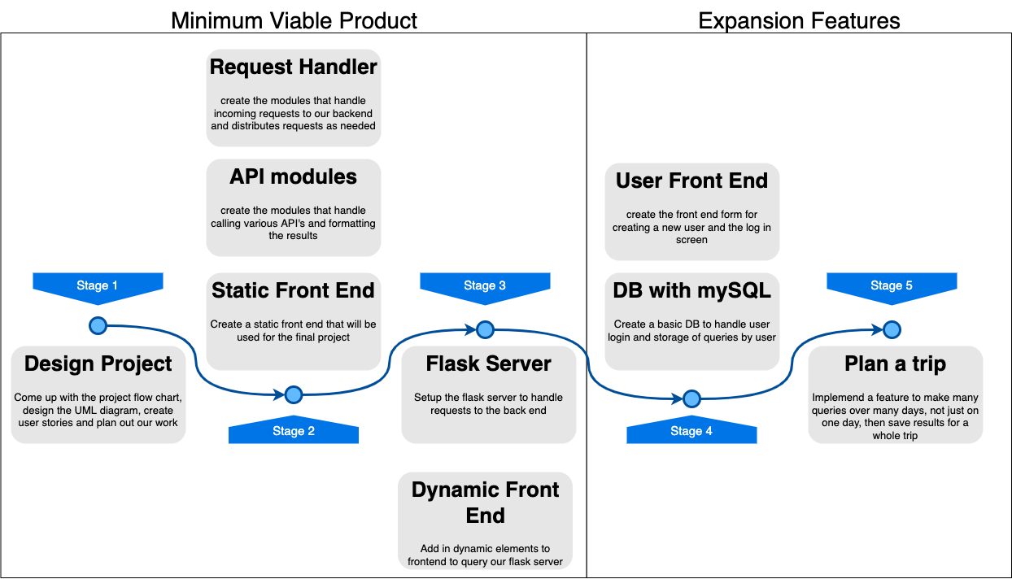

Slide 6
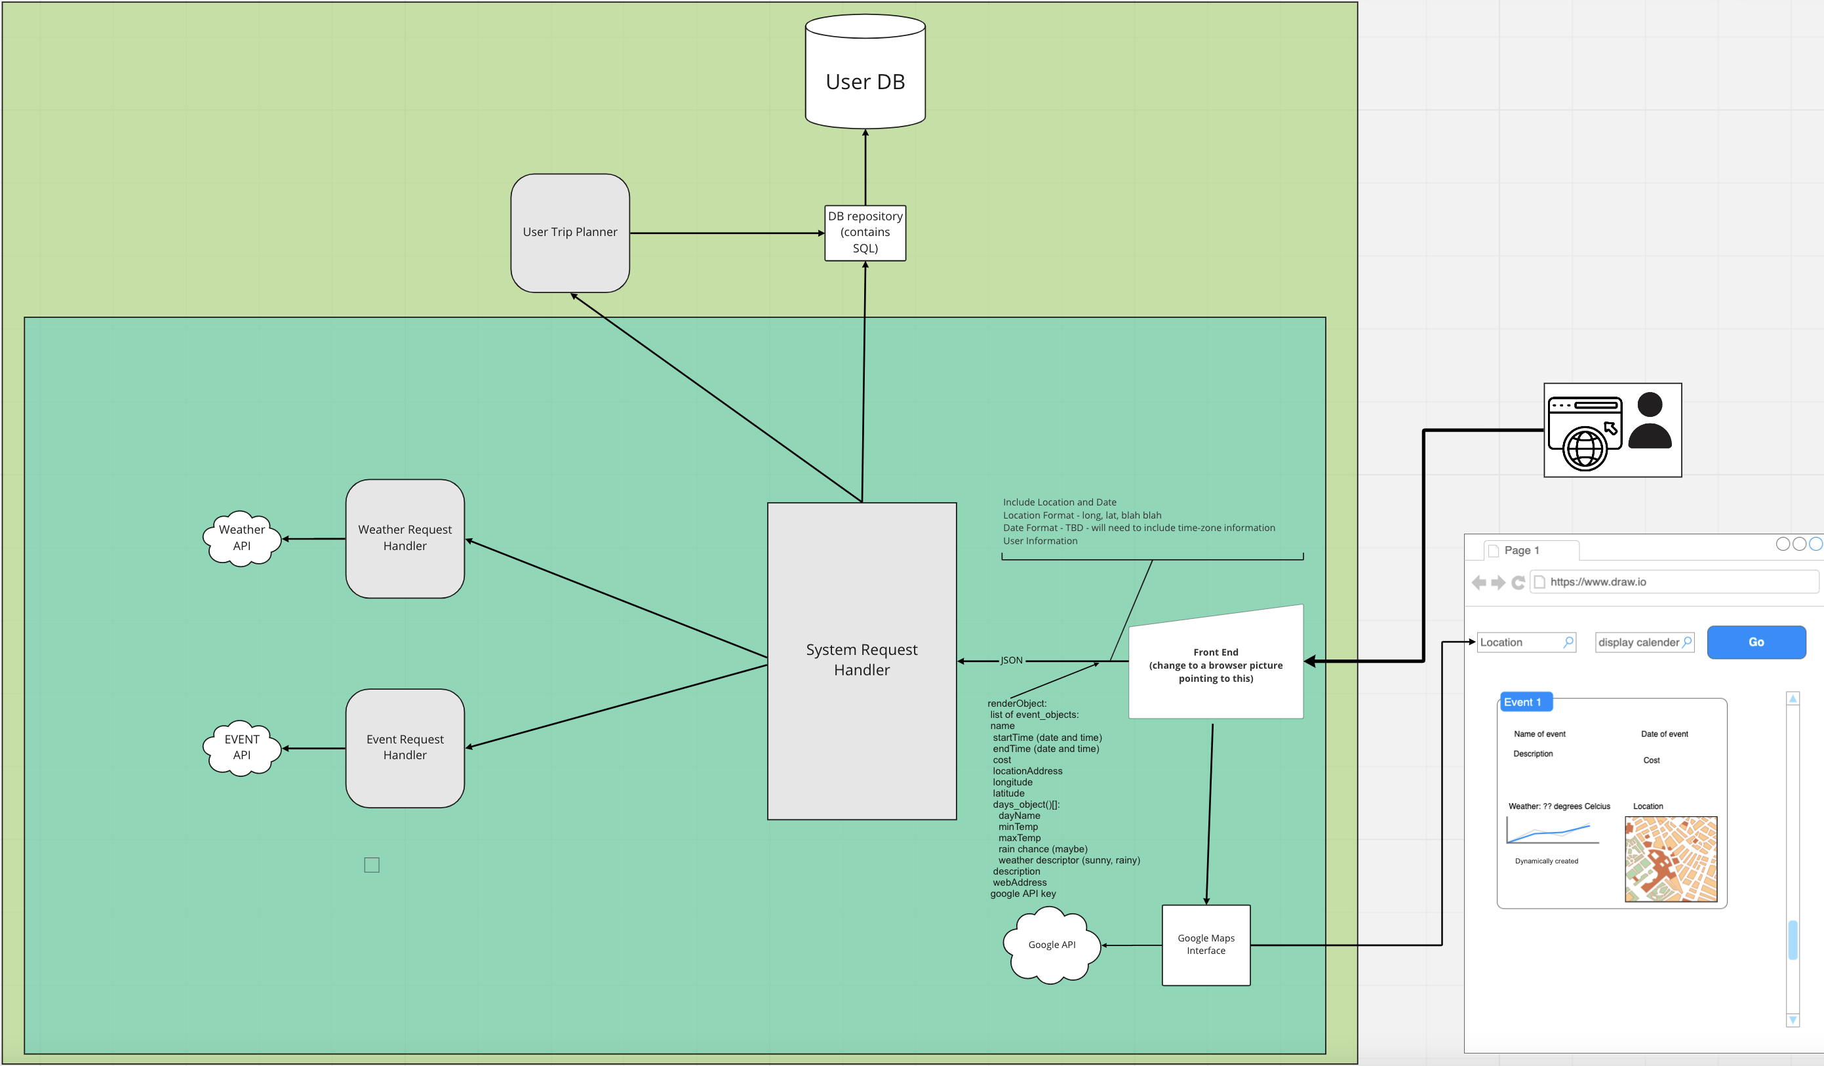

Slide 7

DEMO

